Slide 1


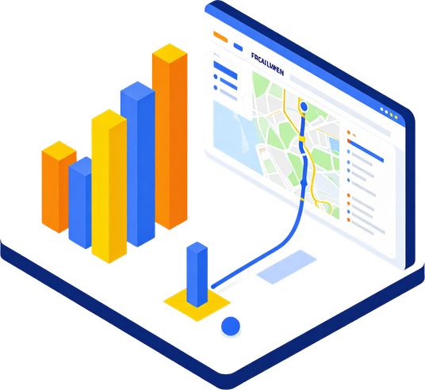

Milestone 2
BENGALURU TRANSPORT
PERFORMANCE ANALYSIS
Milestone 2 – Data Visualization Using Power BI

Slide 2



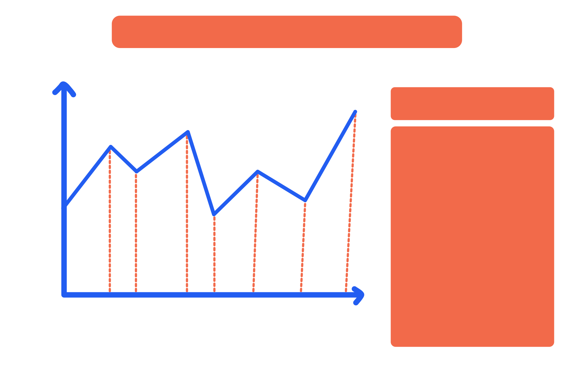
BENGALURU TRANSPORT
PERFORMANCE ANALYSIS
Introduction – Project Overview
This project analyzes Bengaluru's public transport system using route, passenger, stop, trip, and direction data. Leveraging Power BI, Power Query, and DAX, the study aims to uncover performance patterns and support data-driven transit planning decisions.

Slide 3


OBJECTIVES
Project Goals &
Research Objectives
Evaluate route-wise passenger performance across Bengaluru
Identify passenger intensity patterns using heat map analysis
Study movement and route connectivity via flow map analysis
Generate actionable insights for transport planning decisions

Slide 4


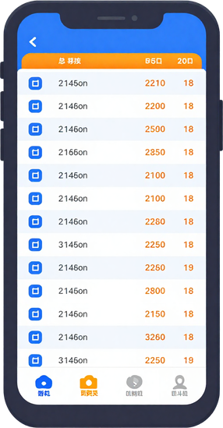

DATASET
OVERVIEW
Route, Passenger, Stop, Trip & Direction Data
Five core data tables sourced for analysis: Route Data (route IDs, names, types), Passenger Data (boardings, alightings), Stop Data (stop locations, sequences), Trip Data (schedules, frequencies), and Direction Data (inbound/outbound flows).

Slide 5



TOOLS & TECHNOLOGIES USED
Power BI | Power Query | DAX
Power BI enables interactive dashboards and transport visualizations. Power Query handles data cleaning and transformation of route, stop, and trip datasets. DAX (Data Analysis Expressions) powers calculated metrics, KPIs, and dynamic analysis for Bengaluru transit performance.

Slide 6

ROUTE & PASSENGER
ANALYSIS
Route-Wise Passenger Performance
Comparative analysis of passenger volumes across Route A, Route B, Route C, and Route D. Chart values represent [Passenger Count] per route. Identifies high-demand corridors for optimized resource allocation.

Slide 7

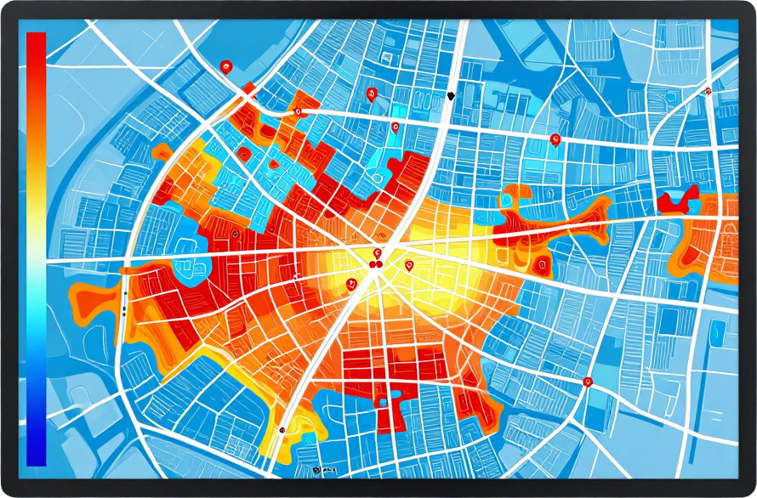
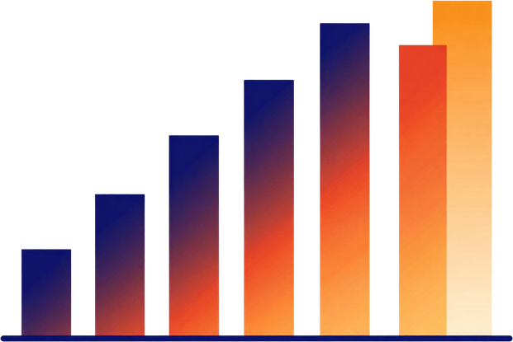
HEAT MAP
ANALYSIS
Passenger Intensity Across Routes & Stops
Heat map visualization highlighting high-density boarding zones, peak-hour congestion points, and underutilized stops across the Bengaluru transit network.

Slide 8

FLOW MAP
ANALYSIS
Movement Patterns & Route Connectivity in Bengaluru
Origin-Destination Flow → Mapping passenger movement between key zones
Route Connectivity → Identifying linked and overlapping bus corridors
Stop-to-Stop Flow → Visualizing passenger transitions at interchange stops
Major Corridors → Highlighting high-frequency and high-demand routes
Connectivity Patterns → Detecting gaps and underserved areas in the network

Slide 9


KEY
INSIGHTS
& FINDINGS
Major Analytical
Observations
Route analysis revealed high-demand corridors with uneven load distribution. Heat maps identified peak congestion zones. Flow maps highlighted key connectivity gaps. Passenger trends showed time-based ridership patterns across stops.

Slide 10
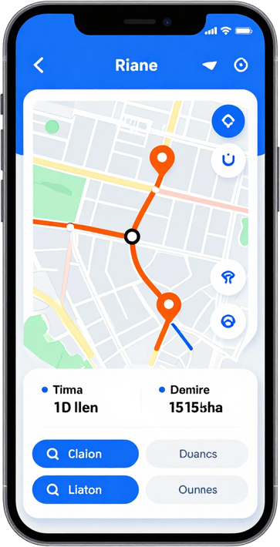

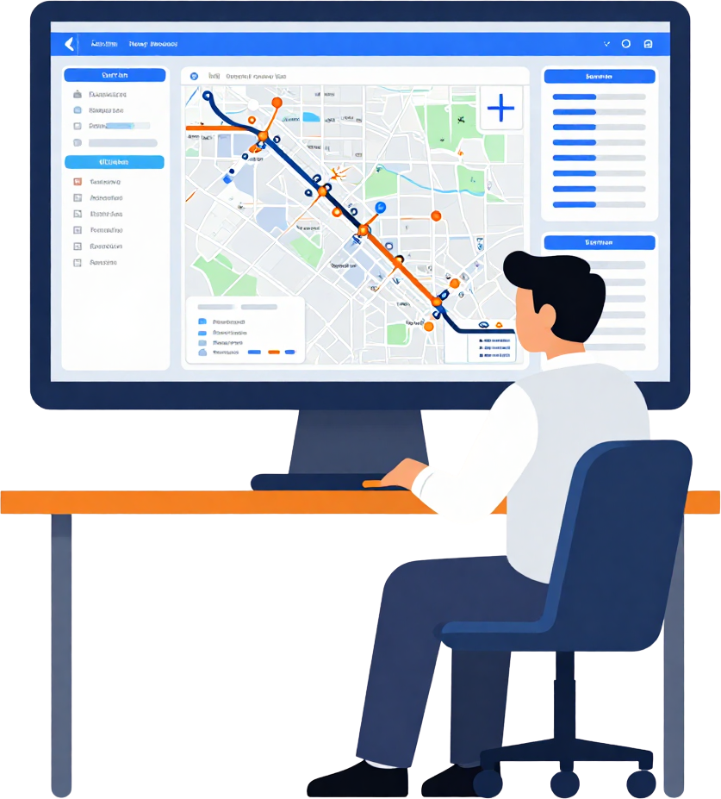




CONCLUSION
Importance of Transport Performance Analysis
Understand passenger demand patterns across Bengaluru
Improve route planning and resource allocation
Identify high-intensity stops and underserved areas
Enable data-driven decisions for transit authorities

